Slide 1
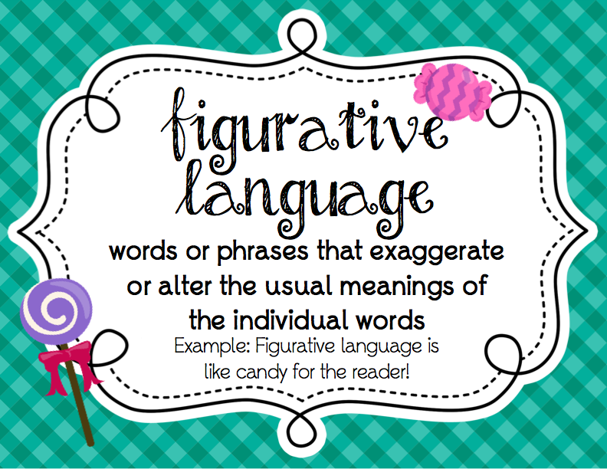

Slide 2
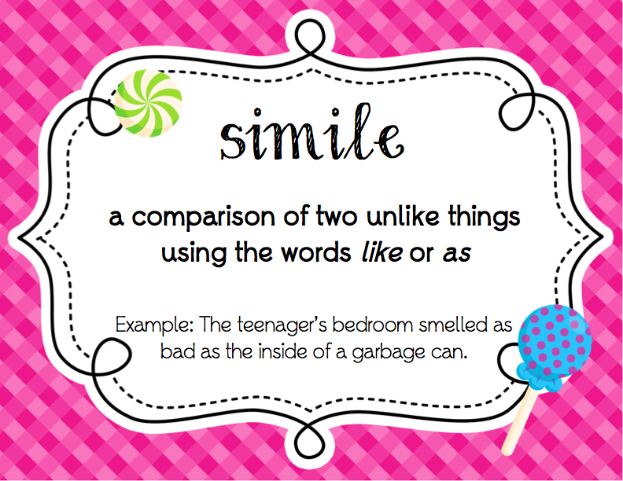

Slide 6
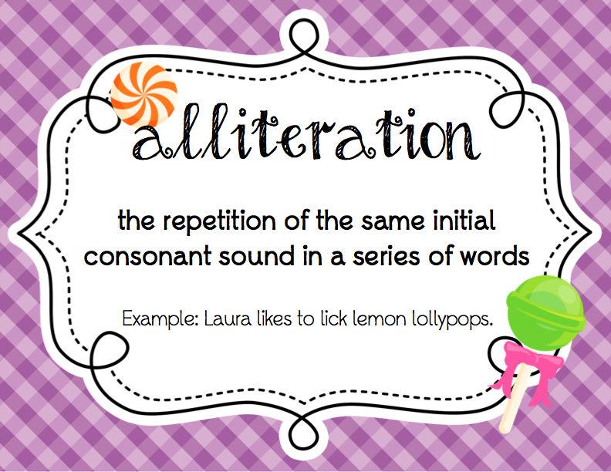

Slide 9
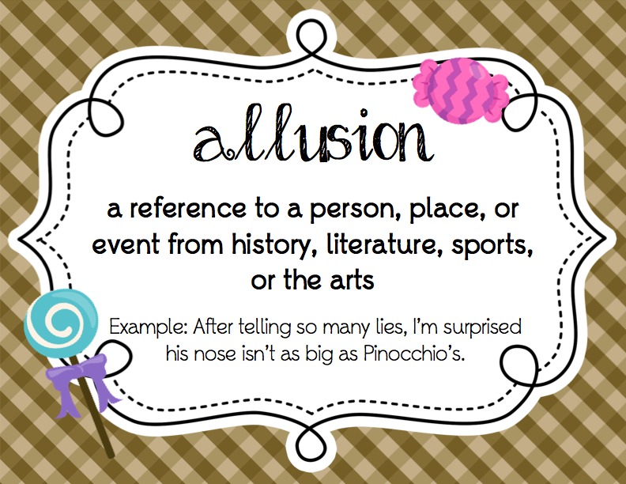

Slide 12
Assonance
the act of repeating a vowel sound in a phrase or sentence, often in poetry
Example: Men sell wedding bells.

Slide 13
End Rhyme
when a poem has lines ending with words that sound the same.
Example: Star light,
star bright

Slide 14
Internal Rhyme
rhyme between a word within a line and another either at the end of the same line or within another line.
Example: I took the car and it wasn’t far.

